Slide 1
More about OOP and ADTs
Classes
Chapter 4
Nyhoff, ADTs, Data Structures and Problem Solving with C++, Second Edition, © 2005 Pearson Education, Inc. All rights reserved. 0-13-140909-3

Slide 2
Chapter Contents
4.1 Procedural vs. Object-Oriented Programming
4.2 Classes
4.3 Example: A First Version of a User-Defined Time Class
4.4 Class Constructors
4.5 Other Class Operators
Nyhoff, ADTs, Data Structures and Problem Solving with C++, Second Edition, © 2005 Pearson Education, Inc. All rights reserved. 0-13-140909-3

Slide 3
Chapter Objectives
Contrast OOP with procedural programming
Review classes in C++
Study in detail a specific example of how a class is built
Show how operators can be overloaded for new types
Show how conditional compilation directives are used to avoid redundant declarations
Discuss pointers to class objects – the this pointer, in particular
Nyhoff, ADTs, Data Structures and Problem Solving with C++, Second Edition, © 2005 Pearson Education, Inc. All rights reserved. 0-13-140909-3

Slide 4
Contrast Procedural, Object Oriented Paradigms
Procedural
Action-oriented — concentrates
on the verbs
Programmers:
  Identify basic tasks to solve problem
  Implement actions to do tasks as subprograms (procedures/functions/
  subroutines)
  Group subprograms into programs/modules/libraries,
  together make up a complete system for solving the problem
Object-oriented
Focuses on the nouns of problem specification
Programmers:
  Determine objects needed for problem
  Determine how they should work together to solve the problem.
  Create types called classes made up of
    data members
    function members to operate on the data.
  Instances of a type (class) called objects.
Nyhoff, ADTs, Data Structures and Problem Solving with C++, Second Edition, © 2005 Pearson Education, Inc. All rights reserved. 0-13-140909-3

Slide 5
Structs and Classes
Similarities
Essentially the same syntax
Both are used to model objects with multiple attributes (characteristics)
  represented as data members
  also called fields … or …
  instance or attribute variables).
Thus, both are used to process non-homogeneous data sets.
Nyhoff, ADTs, Data Structures and Problem Solving with C++, Second Edition, © 2005 Pearson Education, Inc. All rights reserved. 0-13-140909-3

Slide 6
Structs vs. Classes
Differences
No classes in C
Members public by default
Can be specified private
Both structs and classes in C++
Structs can have members declared private
Class members are private by default
Can be specified public
Nyhoff, ADTs, Data Structures and Problem Solving with C++, Second Edition, © 2005 Pearson Education, Inc. All rights reserved. 0-13-140909-3

Slide 7
Advantages in C++
(structs and Classes)
C++ structs and classes model objects which have:
  Attributes represented as data members
  Operations represented as functions (or methods)
Leads to object oriented programming
  Objects are self contained
  "I can do it myself" mentality
  They do not pass a parameter to an external function
Nyhoff, ADTs, Data Structures and Problem Solving with C++, Second Edition, © 2005 Pearson Education, Inc. All rights reserved. 0-13-140909-3

Slide 8
Class Declaration
Syntax
class ClassName
{
public:
Declarations of public members
private:
Declarations of private members
};
Nyhoff, ADTs, Data Structures and Problem Solving with C++, Second Edition, © 2005 Pearson Education, Inc. All rights reserved. 0-13-140909-3

Slide 9
Designing a Class
Data members normally placed in private: section of a class
Function members usually in public: section
Typically public: section followed by private:
  although not required by compiler
Nyhoff, ADTs, Data Structures and Problem Solving with C++, Second Edition, © 2005 Pearson Education, Inc. All rights reserved. 0-13-140909-3

Slide 10
Class Libraries
Class declarations placed in header file
  Given .hpp extension
  Contains data items and prototypes
Implementation file
  Same prefix name as header file
  Given .cpp extension
Programs which use this class library called client programs
Nyhoff, ADTs, Data Structures and Problem Solving with C++, Second Edition, © 2005 Pearson Education, Inc. All rights reserved. 0-13-140909-3

Slide 11
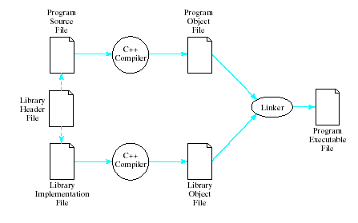
Translating a Library
Nyhoff, ADTs, Data Structures and Problem Solving with C++, Second Edition, © 2005 Pearson Education, Inc. All rights reserved. 0-13-140909-3

Slide 12
Example of User-Defined
Time Class
Recall Time struct from previous chapter
  Actions done to Time object required use of Time parameter in the functions
Now we create a Time class
  Actions done to Time object, done by the object itself
Note interface for Time class object,
Fig. 4.2
  Data members private – inaccessible to users of the class
  Information hiding
Nyhoff, ADTs, Data Structures and Problem Solving with C++, Second Edition, © 2005 Pearson Education, Inc. All rights reserved. 0-13-140909-3

Slide 13
Constructors
Note constructor definition in Time.cpp example
Syntax
ClassName::ClassName (parameter_list)
: member_initializer_list
{
// body of constructor definition
}
Nyhoff, ADTs, Data Structures and Problem Solving with C++, Second Edition, © 2005 Pearson Education, Inc. All rights reserved. 0-13-140909-3

Slide 14
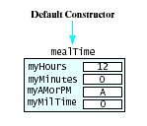
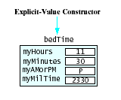
Constructors
Results of default constructor
Results of explicit-value
constructor
Nyhoff, ADTs, Data Structures and Problem Solving with C++, Second Edition, © 2005 Pearson Education, Inc. All rights reserved. 0-13-140909-3

Slide 15
Overloading Functions
Note existence of multiple functions with the same name
Time();
Time(unsigned initHours,
unsigned initMinutes,
char initAMPM);
  Known as overloading
Compiler compares numbers and types of arguments of overloaded functions
  Checks the "signature" of the functions
Nyhoff, ADTs, Data Structures and Problem Solving with C++, Second Edition, © 2005 Pearson Education, Inc. All rights reserved. 0-13-140909-3

Slide 16
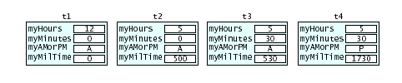
Default Arguments
Possible to specify default values for constructor arguments
Time(unsigned initHours = 12,
unsigned initMinutes = 0,
char initAMPM = 'A');
Consider
Time t1, t2(5), t3(6,30), t4(8,15,'P');
Nyhoff, ADTs, Data Structures and Problem Solving with C++, Second Edition, © 2005 Pearson Education, Inc. All rights reserved. 0-13-140909-3

Slide 17
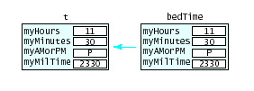
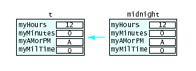
Copy Operations
During initialization
Time t = bedTime
During Assignment
t = midnight;
Nyhoff, ADTs, Data Structures and Problem Solving with C++, Second Edition, © 2005 Pearson Education, Inc. All rights reserved. 0-13-140909-3

Slide 18
Other Class Operations
Accessors and Mutators
  See "get" and "set" functions
Overloading operators
  Same symbol can be used more than one way
  Note declaration for I/O operators << and >>
  Note definition of overloaded I/O operators
Nyhoff, ADTs, Data Structures and Problem Solving with C++, Second Edition, © 2005 Pearson Education, Inc. All rights reserved. 0-13-140909-3

Slide 19
Friend Functions
Note use of two functions used for output
  display() and operator<<()
Possible to specify operator<<() as a "friend" function
  Thus given "permission" to access private data elements
Declaration in .h file (but not inside class)
friend ostream & operator<<(
ostream & out, const Time & t)
Nyhoff, ADTs, Data Structures and Problem Solving with C++, Second Edition, © 2005 Pearson Education, Inc. All rights reserved. 0-13-140909-3

Slide 20
Friend Functions
Definition in .cpp file
ostream & operator<<(
ostream & out, const Time & t)
{ out << t.myHours<<":"
<<(t.myMinutes< 10? "0": "")
<<t.myMinutes
<< ' '<<t.myAMorPM<<".M.";
return out;
}
Note - a friend function not member function
  not qualified with class name and ::
  receives class object on which it operates as a parameter
Author prefers not to use friend function
Violates principle of information hiding
Nyhoff, ADTs, Data Structures and Problem Solving with C++, Second Edition, © 2005 Pearson Education, Inc. All rights reserved. 0-13-140909-3

Slide 21
Other Operations
Advance Operation
  Time object receives a number of hours and minutes
  Advances itself by adding to myHours, myMinutes
Relational Operators
  Time object compares itself with another
  Determines if it is less than the other
Nyhoff, ADTs, Data Structures and Problem Solving with C++, Second Edition, © 2005 Pearson Education, Inc. All rights reserved. 0-13-140909-3

Slide 22
Redundant Declarations
Note use of #include "Time.h" in
  Time.cpp
  Client program
Causes "redeclaration" errors at compile time
Solution is to use conditional compilation
  Use #ifndef and #define and #endif compiler directives
Nyhoff, ADTs, Data Structures and Problem Solving with C++, Second Edition, © 2005 Pearson Education, Inc. All rights reserved. 0-13-140909-3

Slide 23

Pointers to Class Objects
Possible to declare pointers to class objects
Time * timePtr = &t;
Access with
timePtr->getMilTime() or
(*timePtr).getMilTime()
Nyhoff, ADTs, Data Structures and Problem Solving with C++, Second Edition, © 2005 Pearson Education, Inc. All rights reserved. 0-13-140909-3

Slide 24
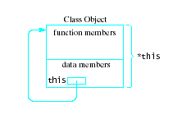
The this Pointer
Every class has a keyword, this
  a pointer whose value is the address of the object
  Value of *this would be the object itself
Nyhoff, ADTs, Data Structures and Problem Solving with C++, Second Edition, © 2005 Pearson Education, Inc. All rights reserved. 0-13-140909-3

